Slide 1

Building a Customer Intelligence Engine
A Data-Driven Framework for Segmentation, Churn Prediction, and Growth
Deeason Sitaula
July 20, 2025

Slide 2
The Challenge
Our one-size-fits-all approach is limiting growth.
Flat Growth Hidden by Seasonality: Most sales come from a short fall peak; the rest of the year underperforms.
Customers Were Cross-Buying Themselves- But We Weren’t Helping: Strong cross buying patterns exist, but we weren’t using them to drive bundles or recommendations.
Over-Reliance on Few Products: 23% of products drive 80% of sales, yet resources were spread too thin.
Nutshell: We lacked insight into customer behavior, product performance, and seasonal dynamics leaving revenue and retention opportunities untapped.

Slide 3
The Solution
We built an end-to-end data science pipeline to segment customers, predict churn, forecast customer lifetime value (CLV) and uncover high-impact cross-sell opportunities.
Key insights:
A small group of “Champions” customers drive 75%+ of revenue.
First-to-second purchase is the most critical conversion point in the customer journey.
Purchase frequency and product bundling are powerful levers for retention and revenue growth.

Slide 4
Top Recommendations:
Retain Champions with a VIP program powered by real-time churn alerts.
Win Back At-Risk Revenue using automated re-engagement trigged by behavior changes.
Accelerate Second Purchases with targeted onboarding journeys for new customers.

Slide 5
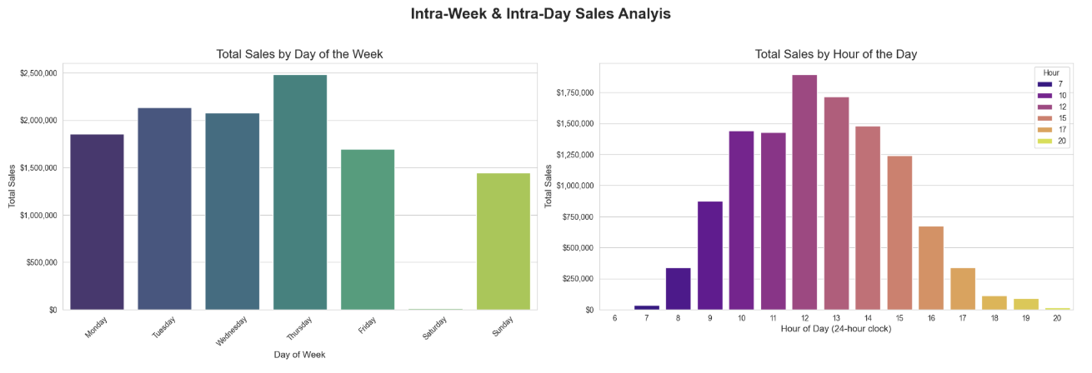
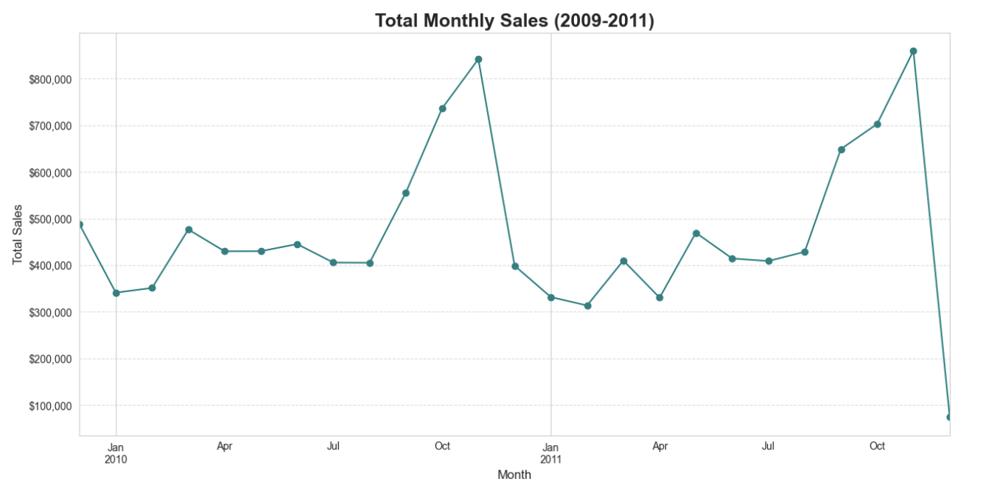
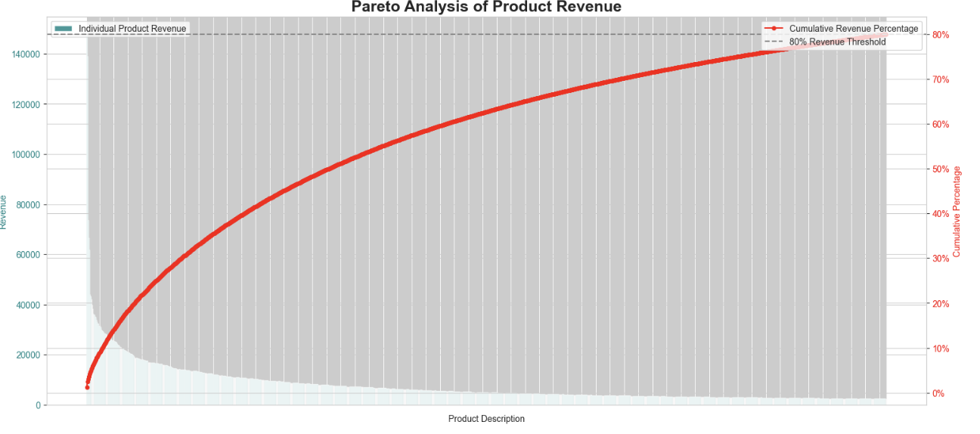
The Business at a Glance (Key EDA Findings)
B2B Wholesaler
Sales Trends: Peak in November, Activity During Business Hours
23% of products drive 80% of revenue

Slide 6

Approach: A 6-Phase Analytical Framework
1. Preprocessing
2. EDA
3. RFM Segmentation
4. Hypothesis Testing
5. Predictive Analytics (CLV & Churn)
6. Affinity Analysis

Slide 7

Validating Our Insights with Statistical Rigor
Key Assumptions Were Proven to be Statistically Significant.
Used ANOVA to validate key business questions.
Segments differ in Average Purchase Value.
Segments differ in Product Variety.
Takeaway: High- value customers = Frequency + Value + Variety.

Slide 8
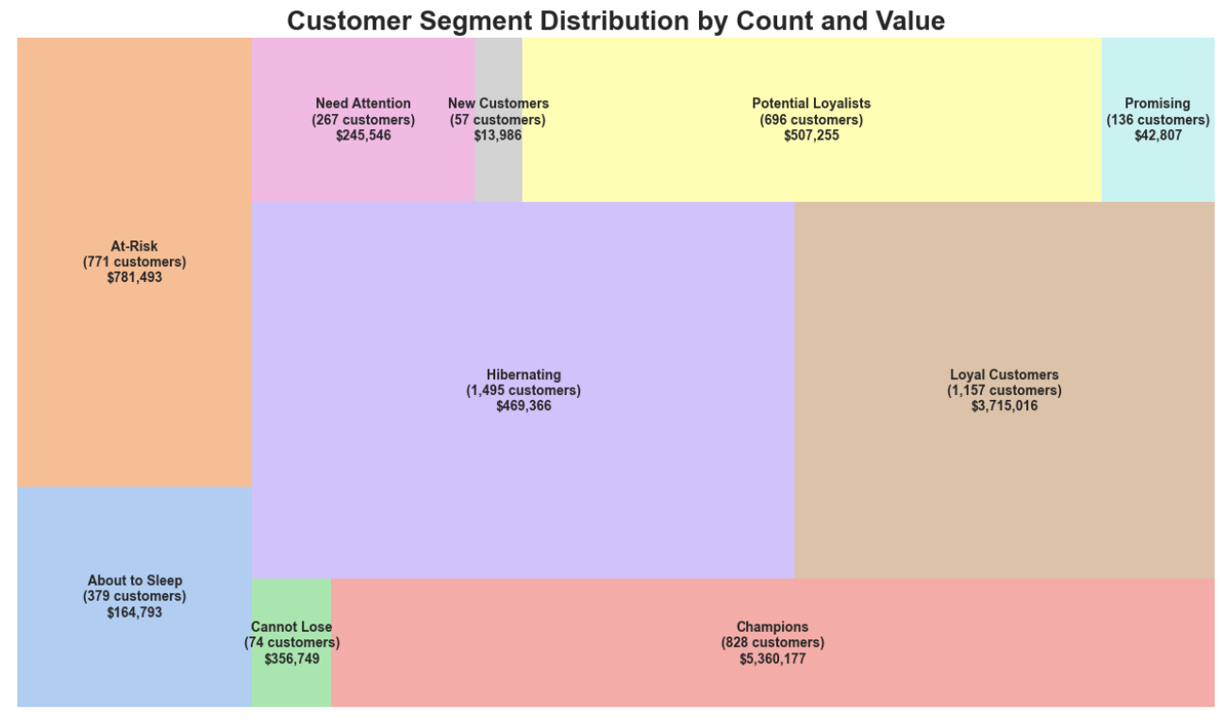
Finding 1: Defining Our Customer Segments
Not all Customers Are Created Equal.
Segmented into 10 groups using region-aware RFM.
Key segments: Champions(best), Hibernating (inactive)

Slide 9
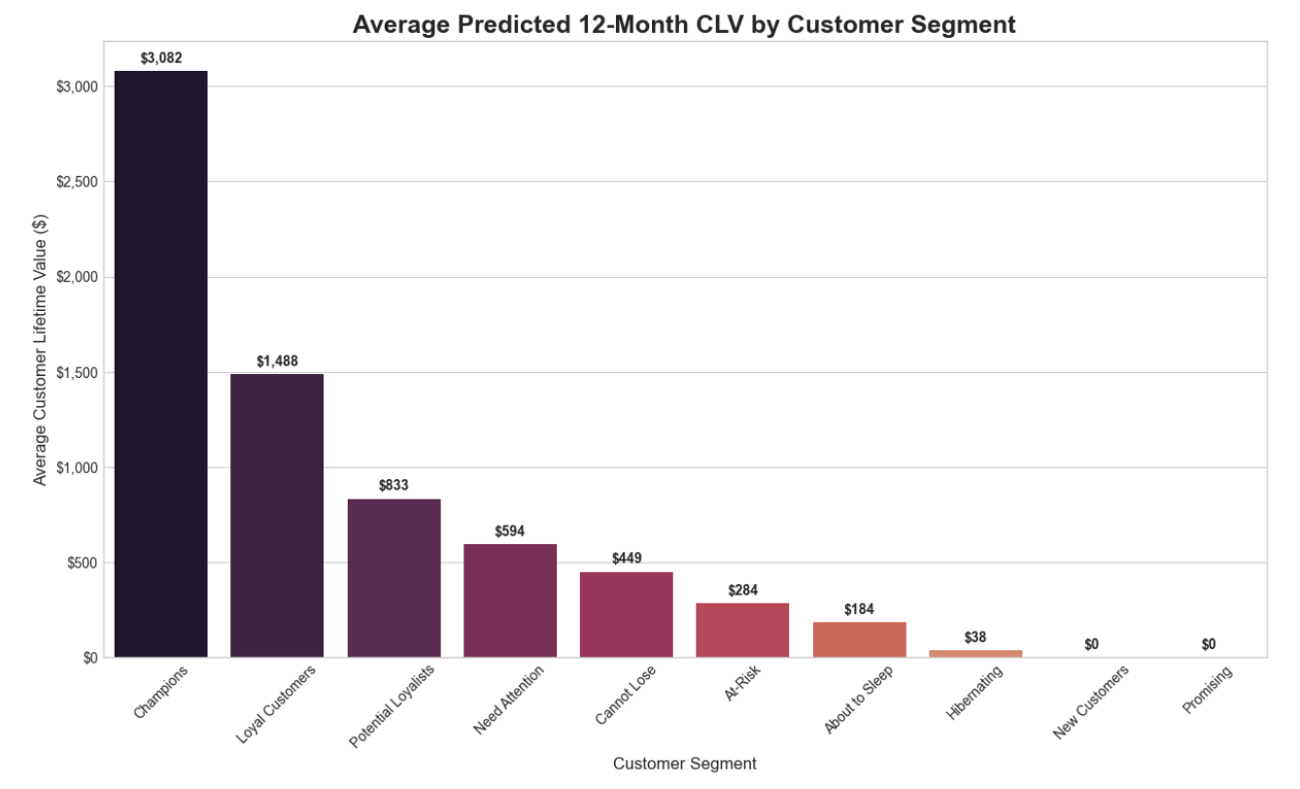
Finding 2: Predicting Future Value (CLV)
“Champions” Are Exponentially More Valuable to Our Future
Champions’ CLV: $4,781 vs Loyal: $1,987
New customers have $0 CLV until second purchase.
Second purchase = Key driver of long-term value.

Slide 10
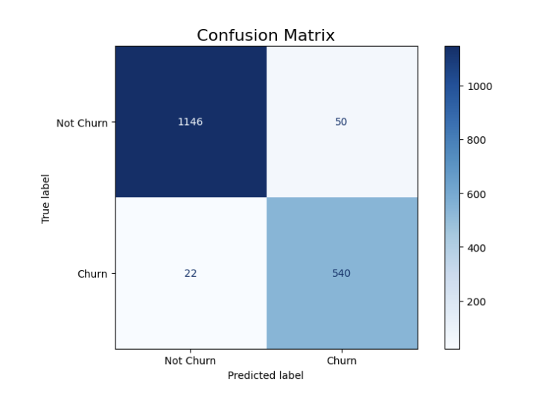
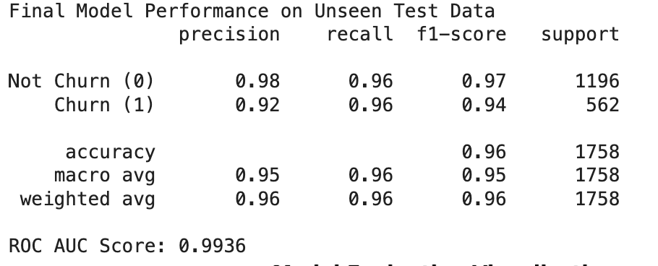
Finding 3: Proactively Predicting Churn
We can now identify customers who are likely to stop buying with 96% accuracy.
We catch nearly all at-risk customers (98% detection rate)
Our model is smart: it avoids false alarms, with 92% precison.
Key Insight: The longer a customer goes without buying, the more likely they are to churn.

Slide 11
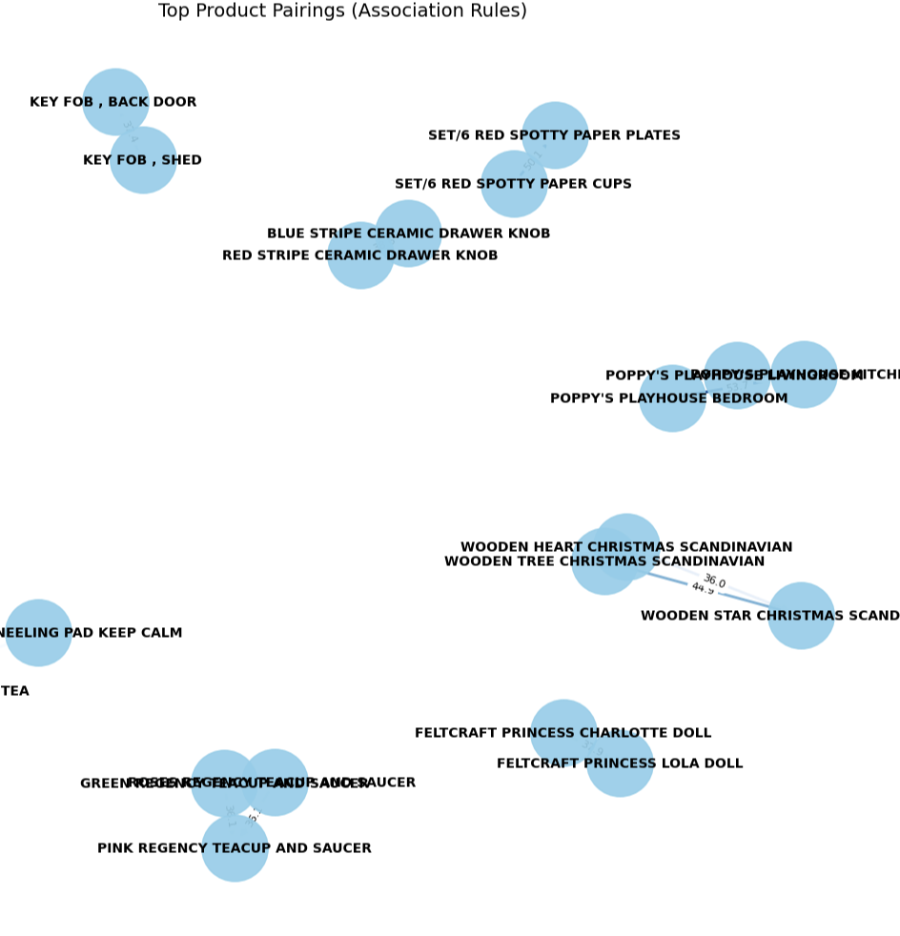
Finding 4: The Hidden Cross-Sell Opportunity
Customers often buy certain items together not by chance, but by pattern.
Insight: Some product pairs are 50-56x more likely to be purchase together.
Opportunity:
Suggest related items in cart and checkout.
Create bundles to increase average order size.
Send follow-up emails with matching product recommendations
Impact: Drives higher revenue through smarter cross-selling

Slide 12

The Action Plan: Three Levers for Growth
A 3-Part Strategy to Systematically Increase Customer Lifetime Value

Slide 13
1.Protect the Core:
Target: Our “Champions” & “Loyal Customers”, who represent over 75% of our revenue.
Action: Launch an exclusive VIP program with personalized account management and early access to new products.
The Engine: Our Churn Prediction Model will act as an early-warning system, flagging high-value customers the moment their behavior changes, allowing us to intervene proactively and protect our most critical revenue source.

Slide 14
2. Recover At-Risk Revenue: The “Win-Back” Engine
Target: Our “At-Risk” & “Cannot Lose” segments, representing over $1.1 million in vulnerable revenue.
The Action: Deploy automated, data driven re-engagement campaigns triggered by increasing Recency scores.
The Insight: Our analysis revealed that Purchase Frequency is a key driver of value. These campaigns will focus on incentivizing the next purchase to pull customers back into an active buying cycle.

Slide 15
3. Activate New Customer: The “Second Purchase” Accelerator
Target: Our “New” & “Promising”
The Action: Implement a “Welcome Journey” email series that is laser-focused on one single goal: securing the second purchase.
The Insight: Our CLV model proved that a new customer’s future value is $0 until they make a second purchase. This is the highest-leverage point in the entire customer lifecycle to create a long-term, valuable relationship.

Slide 16

Conclusion & Activation Roadmap
Proposed Activation Roadmap

Slide 17
Phase 1: Quick Maps (Q3)
Action: A/B test the “Second Purchase” welcome campaign.
Goal: Increase the new customer conversion rate by a target of 15%.
ROI: Every new customer converted into a repeat purchaser has a predictable, non-zero CLV, directly impacting long-term revenue.

Slide 18
Phase 2: Scale & Automate (Q4 )
Action: Fully deploy the Churn Prediction Model into our CRM, providing the marketing team with a daily, prioritized list of at-risk customers.
Goal: Reduce churn within our “Champion” segment by a target of 10%
ROI: Protecting our most valuable segment has an exponential impact on profitability.

Slide 19
Phase 3: Personalize at Scale (Q1)
Action: Productize the Market Basket Analysis rules into a live recommendation engine on our website.
Goal: Increase the average order value by a target of 5% through intelligent cross-selling.
ROI: Every increase in basket size provides immediate, incremental revenue.

